Slide 1
MRK106 Course Resources
Accessing Your Required Course Materials

Slide 2
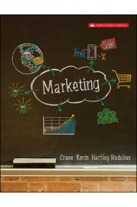
Connect is Required* for Your Course
MRK106
Marketing 1
Fall 2019
Crane
Marketing, 10e
*Connect access is required to complete
Assignments, which are worth a % of your final grade

Slide 3
What is Connect? What are my purchase options? How do I register? How can I get technical support?
Connect is Required for Your Course

Slide 4
Connect makes achieving better grades and managing your time easier than ever.
Study smarter, not harder with a personalized learning path
Track your progress & get instant feedback

Slide 5
How do I Purchase and Register?

Slide 6
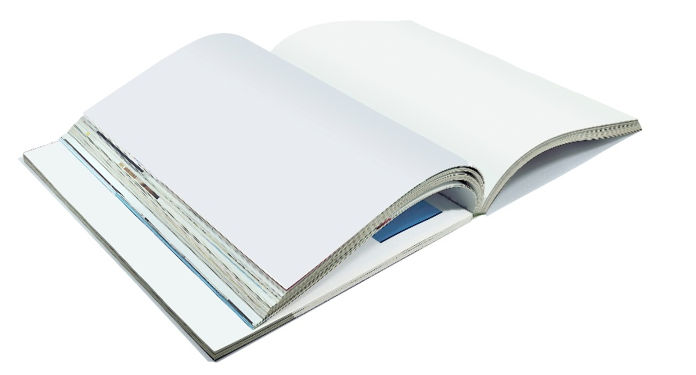
Purchase Options
+
Connect • Bookstore $89.00 ISBN: 9781259272257
Print + Connect • Bookstore $156.25 ISBN: 9781259270901

Slide 7
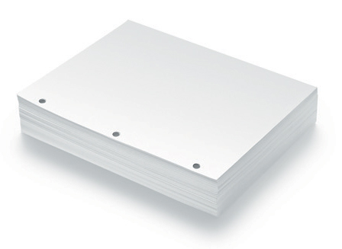
Purchase Options
Optional Upgrade
Purchase a binder-ready loose-leaf print text within your paid Connect account.
• $30.00 plus S&H
Find the loose-leaf order link in the “Student Resources” area of your Connect Library page

Slide 8
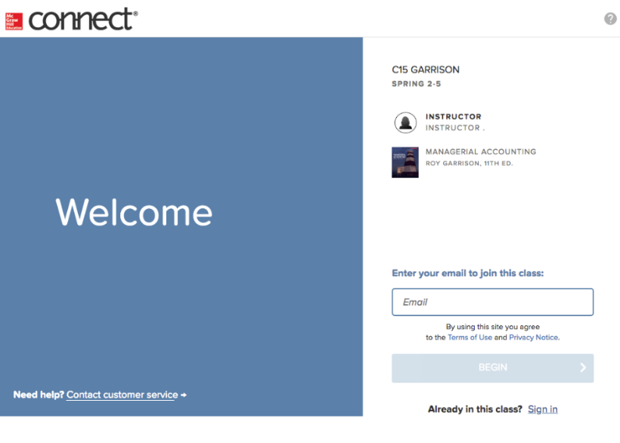
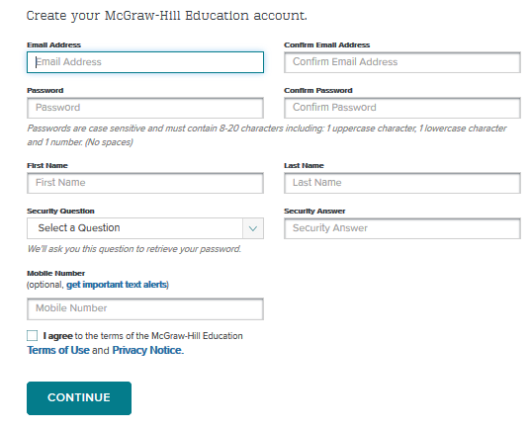
How To Purchase and Register
1 – Go to Connect course URL
https://connect.mheducation.com/class/t-richardson-fall-2019---mrk-106
Enter your email address and choose [BEGIN].
*Using your school e-mail address is recommended*
2 – If you are new to Connect, you will be asked to create a new account

Slide 9
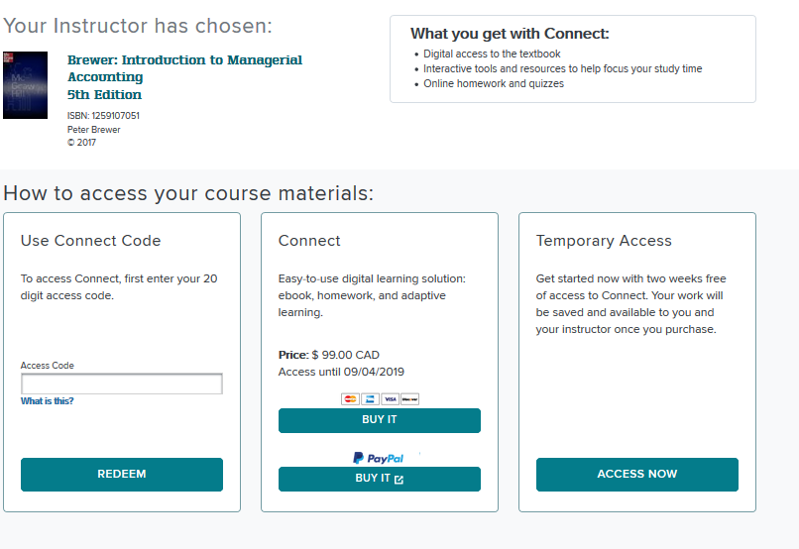
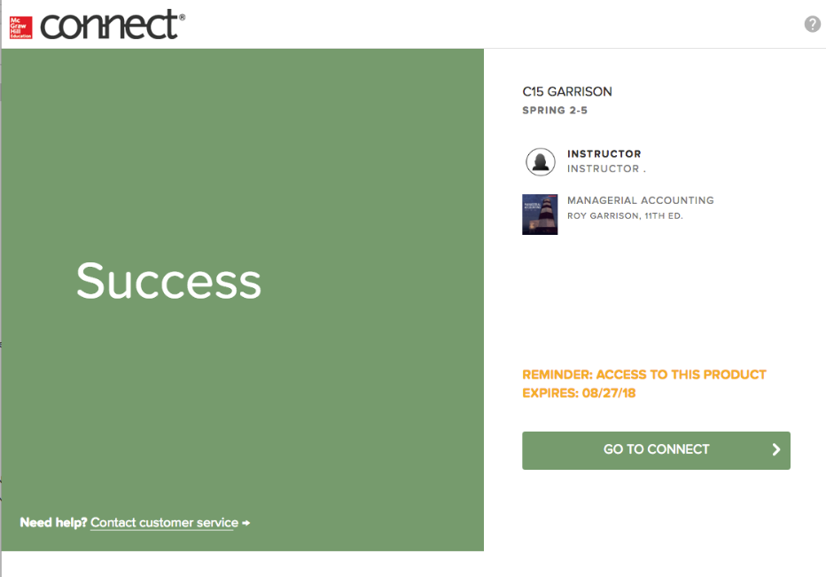
How To Purchase and Register
3 – Enter your Connect code purchased at bookstore, purchase access instantly, or choose Temporary Access (2 week free trial)
Success Tip: Get started right away! The temporary access option is only available for first two weeks of class.

Slide 10
Support & Accessibility
mheducation.ca/student-support
1-800-331-5094
Hours of Support (in Eastern Time)
Sunday: 12:00pm – 12:00am
Monday through Thursday: 24 hours
Friday: 12:00am – 9:00pm
Saturday: 10:00am – 8:00pm
If you have any questions or concerns about interacting with McGraw-Hill products,
please contact your Accessibility Office.

